Slide 1



Website image editing tutorial: WordPress, Paint.NET and PowerPoint(!)
Jukka Niiranen
http://niiranen.info

Slide 2
”So, you need images on your website…”
This presentation is for you if:
You’re a novice in web content publishing
You don’t have experience on working with any graphics software
You need to add smart looking images to your blog or website without too much hassle
I made these slides to help out a friend in managing his WordPress site
Then I realized they might be of use to someone else as well, so I decided to publish them
There are much better ways to achieve the same results, but this is just how I do it

Slide 3
Objectives
Resize large images to fit WordPress pages
Preserve image quality by performing scaling before inserting to page
Optimize page download times by reducing image size
Perform basic image editing
Crop selected areas of an image
Adjust image ratio to fit banners, sidebars etc.
Combine multiple objects
Images and text

Slide 4
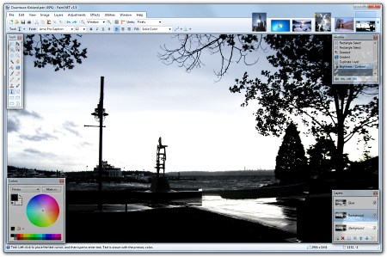
Paint.NET
Free image editor with all the tools needed for adjusting photos for publishing on WordPress
Download from http://www.getpaint.net/download.html

Slide 5
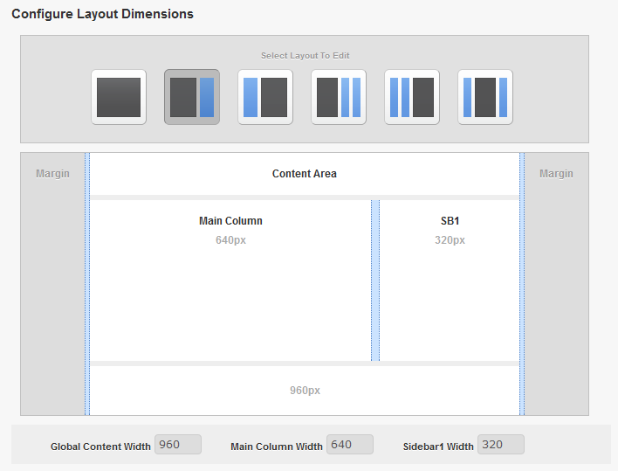

Know your WP theme dimensions
The image on the left is from a WordPress premium theme from PageLines, called PlatformPro. Get it here for $95 if you need an easy to use, drag & drop theme framework.
Maximum width for main sidebar images: 320px
Maximum width for main sidebar images: 320px
Maximum width for main column images: 640px
Maximum width for main column images: 640px

Slide 6
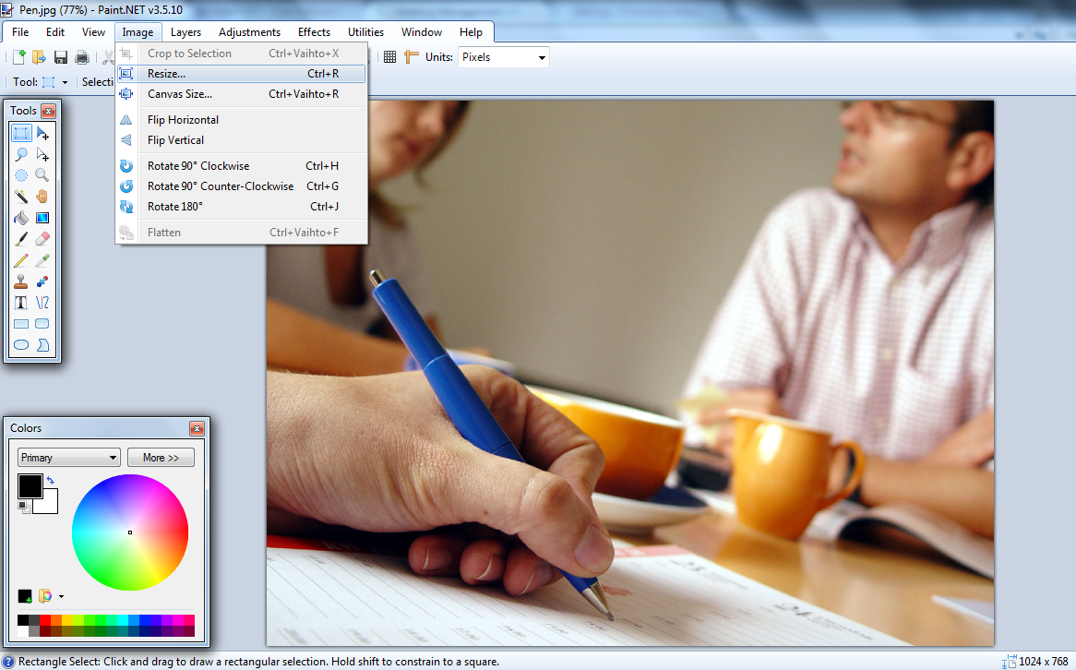
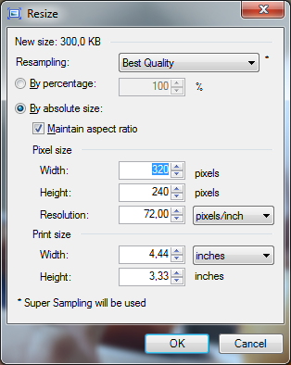
Resize image by setting new width
Use absolute size, maintain aspect ratio
Select ”Image, Resize”
Set width to 320 and click OK

Slide 7
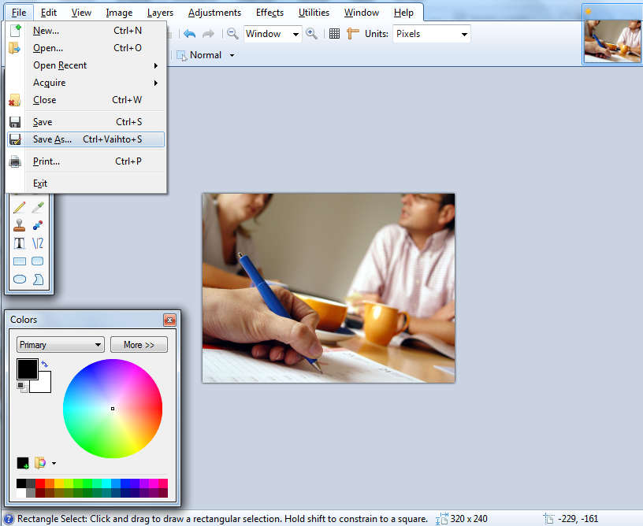
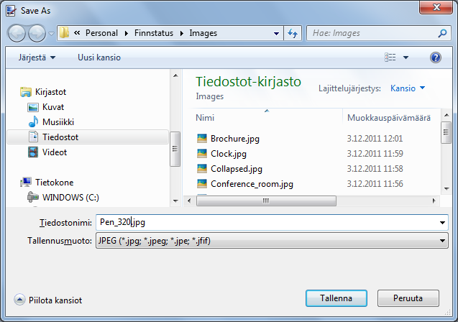
Save new copy of image
Select
”Save as”
Append original file name with the new image width
For photos use JPEG format
(PNG is great when used for ”simple” graphics like diagrams, but with photos the resulting file size will most often be too high)

Slide 8
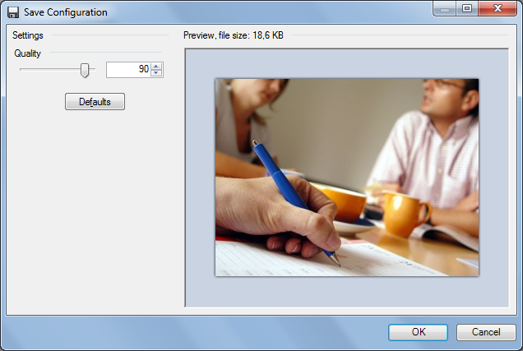
Adjust image compression ratio
Adjust the quality slider
Observe the size and preview image quality
Once you find a good compromise with size and quality (smaller file = faster website), select OK

Slide 9
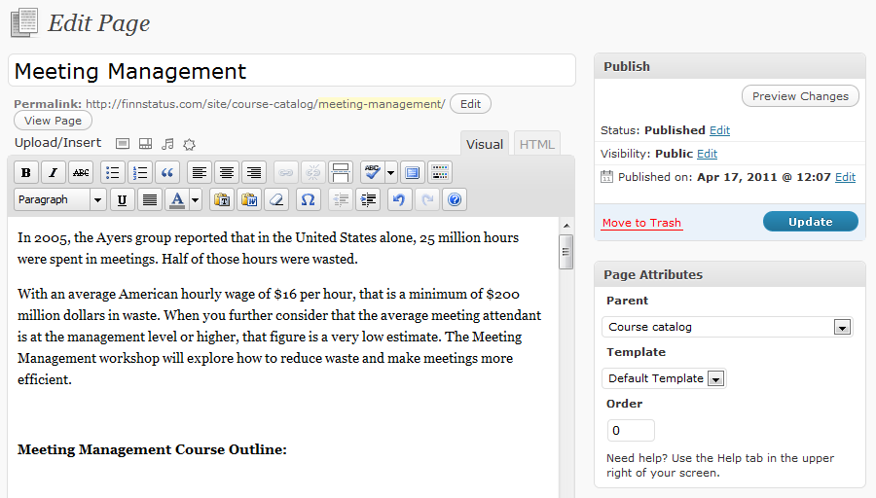
Editing the WP page
Select the image icon in ”Upload/Insert”
Click the place where you want to insert the image (position the cursor in the text)

Slide 10
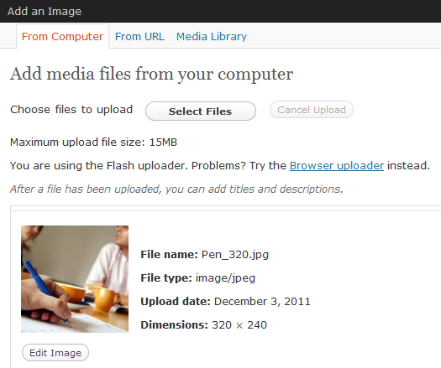
Upload the image
If you want to re-use an existing image that’s already uploaded, open the Media Library tab instead
Click ”Select Files” to open a file upload dialog window

Slide 11
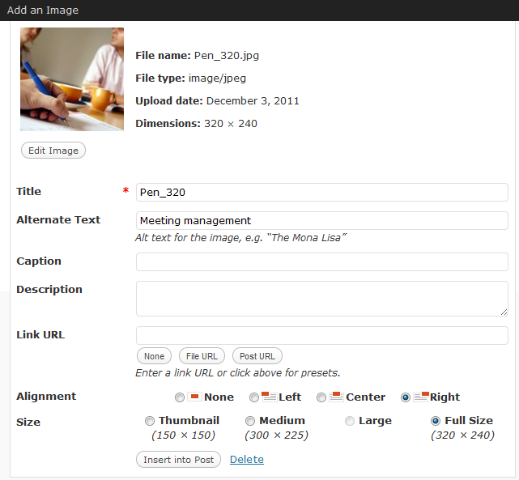
Set image attributes
Title will be shown as a tooltip if user hovers over an image. Can be left as default if your file names are ”sensible”
Alternate text is shown if the user can’t view the image, also important for search engines. Enter a few descriptive keywords.
Use full size (since you’ve already optimized the image size)
Unless you use the image as a link, remove the URL by clicking ”none”
Always set an alignment based on desired layout

Slide 12

Save and view results

Slide 13
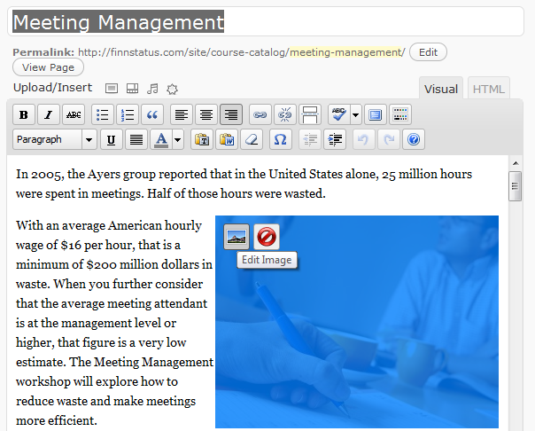
Adjust image properties if needed
To change image properties (alignment etc.), click the image and select Edit Image button
To change image postion, click and hold the image to drag the cursor to the new position

Slide 14
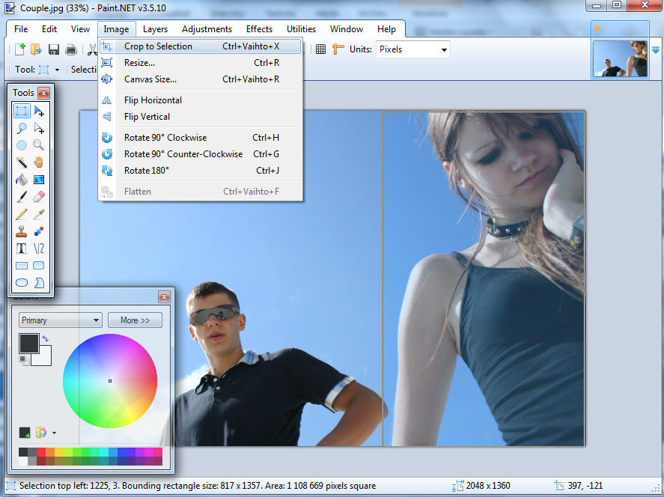
Cropping a part of an image
Select ”Image – Crop to Selection
Select the ”Rectangle Select” tool
Drag and release to the corner you want to crop to
Click and hold from the corner you want to crop from

Slide 15
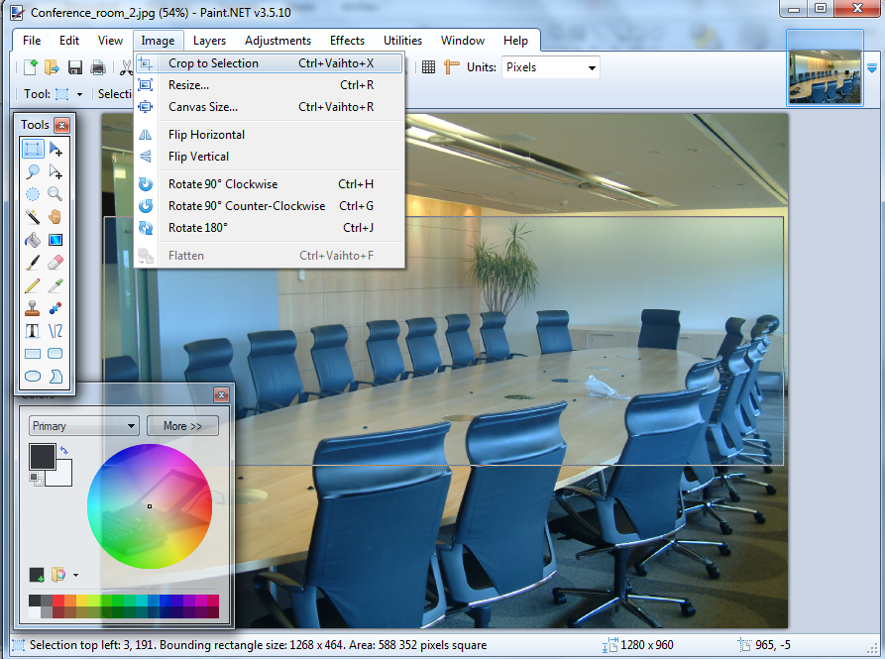


Example of a cropped image

Slide 16
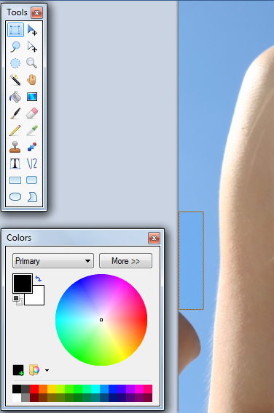
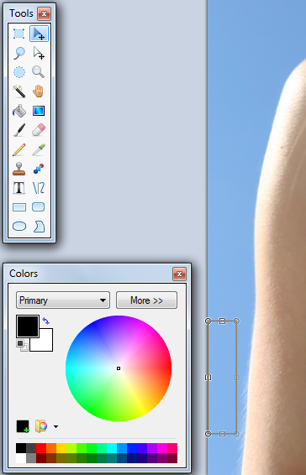
Hiding image areas: copy & paste
Use the ”Rectangle Select” tool to select and copy a suitable area of the image
Paste the copied part back into the image and drag it on top of the area you want to hide

Slide 17
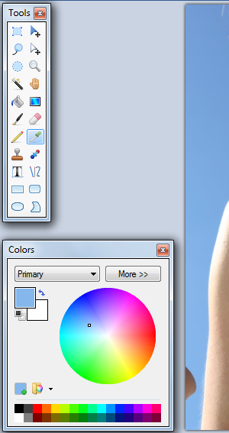
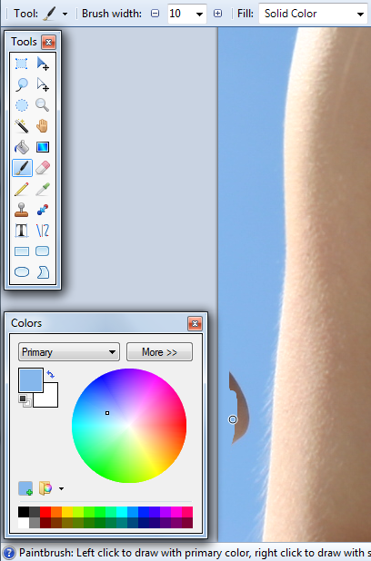
Hiding image areas: paintbrush
Use the ”Color Picker” tool to select a color from next to the area
Use the ”Color Picker” tool to select a color from next to the area
Use the ”Paintbrush” tool to draw over the area with the selected color
Use the ”Paintbrush” tool to draw over the area with the selected color

Slide 18
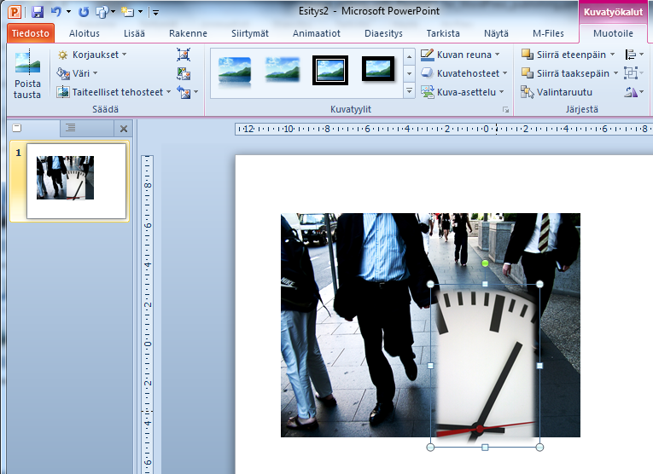
PowerPoint as your canvas (1)
Take advantage of basic image effects like drop shadow, reflection, 3D etc.
For combining images, adding diagrams and text, PowerPoint is a very flexible canvas with familiar object manipulation tools
Insert multiple images on a slide, drag them around and adjust size as needed

Slide 19
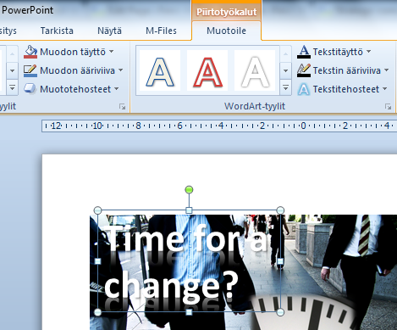
PowerPoint as your canvas (2)
Again, basic effects are at your disposal, but don’t go overboard with them!
PowerPoint was made for visualizing textual information, therefore it has great tools for editing text on top of images, adjusting fonts etc.

Slide 20
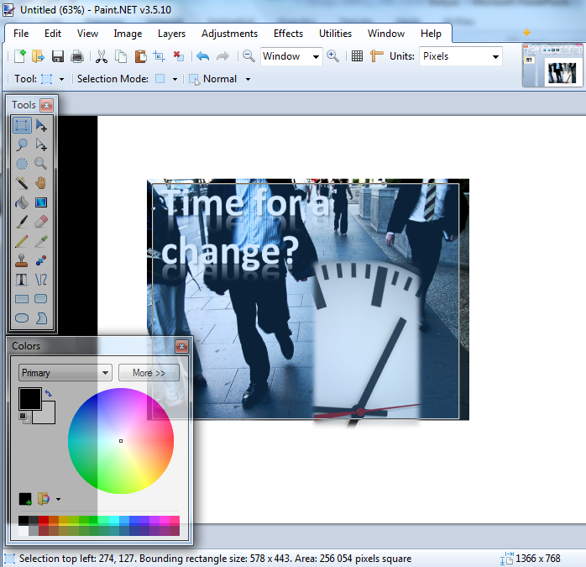
PowerPoint as your canvas (3)
Once you’re ready with editing the objects in PowerPoint, enter presentation mode and take a screenshot with ”Print Screen” button
Paste the resulting screenshot into Paint.NET, crop the image, save it and upload to the web page

Slide 21

PowerPoint/Paint.NET ”mash-up” result

